Slide 1
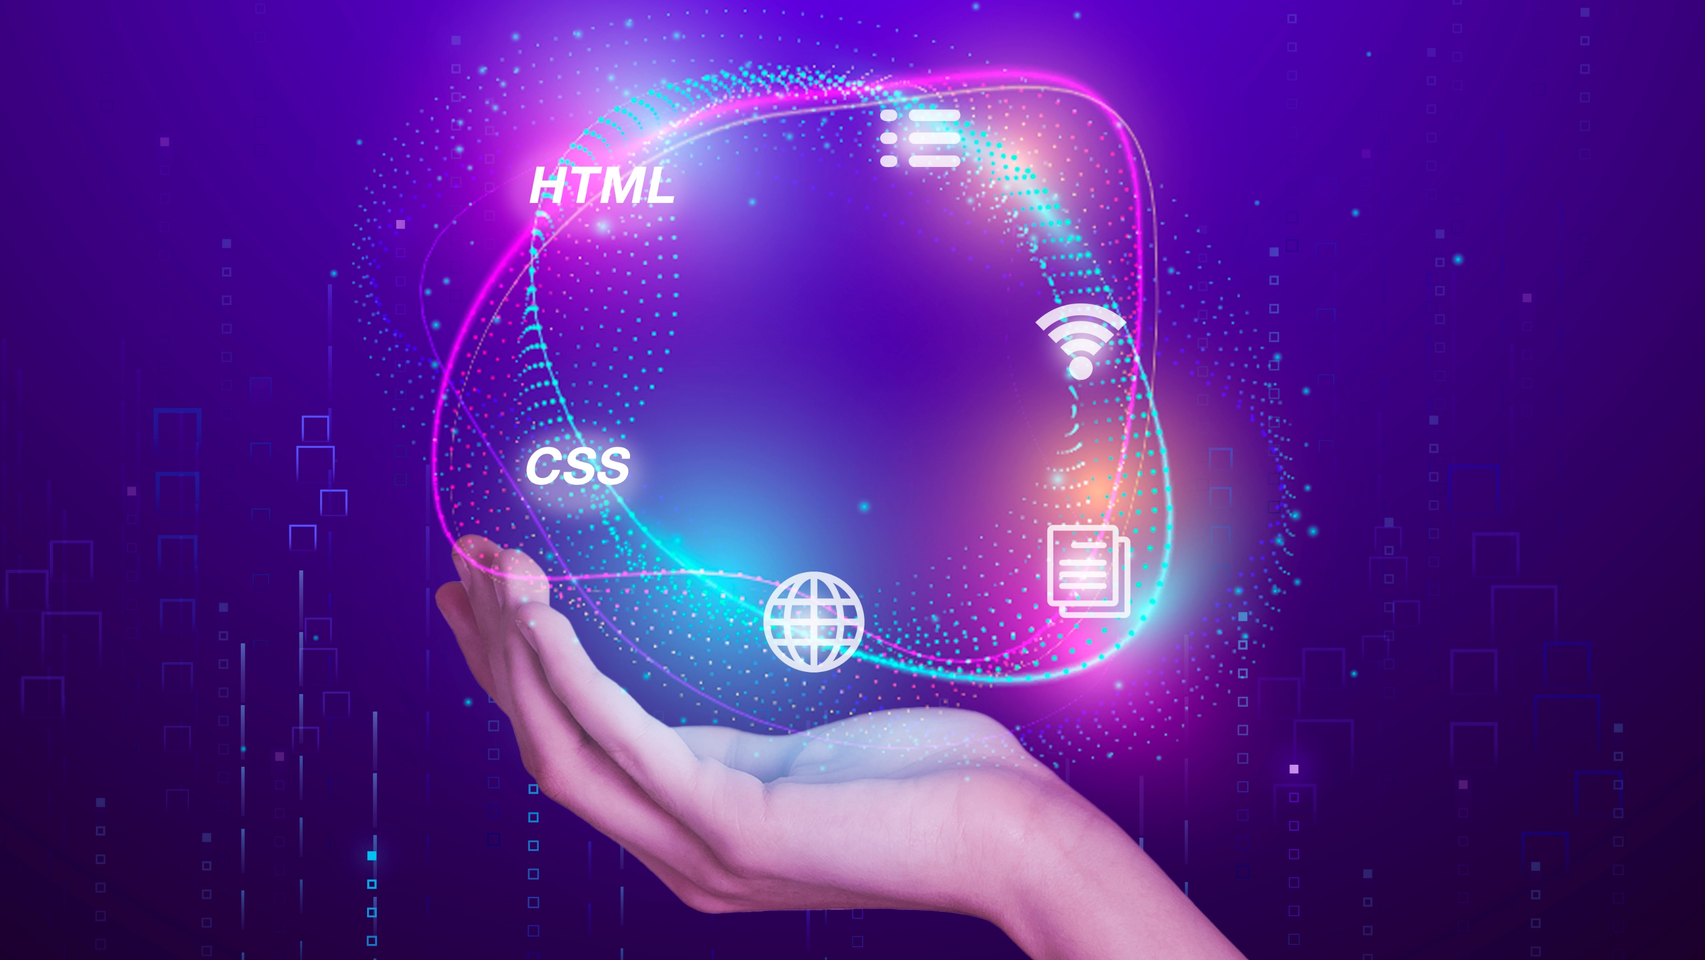
MICROFRONTENDS

Slide 2
Introduction
Microfrontends are transforming how teams build and deploy frontend applications at scale.
Good frontend development is hard. Scaling frontend development so that many teams can work simultaneously on a large and complex product is even harder.
Perhaps you want to build a progressive or responsive web application but can't find an easy place to start integrating these features into the existing code.
Perhaps you want to start using new JavaScript language features (or one of the myriad languages that can compile to JavaScript), but you can't fit the necessary build tools into your existing build process.
Or maybe you just want to scale your development so that multiple teams can work on a single product simultaneously, but the coupling and complexity in the existing monolith means that everyone is stepping on each other's toes.
Lately we are seeing more and more attention being paid to the overall architecture and organizational structures that are necessary for complex, modern web development

Slide 3
What are Microfrontends?
An architectural style where independently deliverable frontend applications are composed into a greater whole.
Some of the key benefits that we've seen from micro frontends are:
smaller, more cohesive and maintainable codebases
more scalable organizations with decoupled, autonomous teams
the ability to upgrade, update, or even rewrite parts of the frontend in a more incremental fashion than was previously possible
The overall idea is to move away from a big monolithic UI to decoupled UI codebases that can be owned, managed, and deployed by separate teams independently.
What can this piece of UI be
Pages – parts of a website owned by specific teams..
Components – Components like header and footer are good candidates for a microfrontend approach as well. They’re relatively static but need to stay consistent across the website and may integrate with teams who own different sets of pages.
Widgets – A recommendation widget may be owned by a recommendations team, for example, and it can be integrated into different parts of the page based on the context.

Slide 4
Incremental upgrades:
For many organizations this is the beginning of their micro frontends journey. The old, large, frontend monolith is being held back by yesteryear's tech stack, or by code written under delivery pressure, and it's getting to the point where a total rewrite is tempting
In order to avoid the perils of a full rewrite, we'd much prefer to strangle the old application piece by piece, and in the meantime continue to deliver new features to our customers without being weighed down by the monolith.
The existing code still needs to be maintained, and in some cases, it may make sense to continue to add new features to it, but now the choice is available.
The endgame here is that we're afforded more freedom to make case-by-case decisions on individual parts of our product, and to make incremental upgrades to our architecture, our dependencies, and our user experience.
If there is a major breaking change in our main framework, each micro frontend can be upgraded whenever it makes sense, rather than being forced to stop the world and upgrade everything at once.

Slide 5
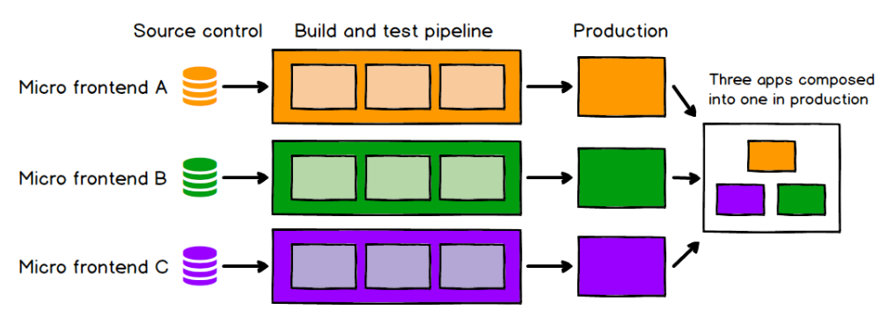
Independent deployment:
Just as with microservices, independent deploy ability of micro frontends is key. This reduces the scope of any given deployment, which in turn reduces the associated risk.
Regardless of how or where your frontend code is hosted, each micro frontend should have its own continuous delivery pipeline, which builds, tests and deploys it all the way to production.
If a given micro frontend is ready to go to production, it should be able to do so, and that decision should be up to the team who build and maintain it.

Slide 6
What is DevOps:
DevOps is a software development methodology that accelerates the delivery of high-performance applications and services by combining and automating the work of software development (Dev) and IT operations (Ops) teams. [IBM]
DevOps is a concept that aims to address the challenges associated with traditional application lifecycle. [Microsoft]
"DevOps is the union of people, process, and products to enable continuous delivery of value to our end users." - Donovan Brown
DevOps is a set of principles, practices, and values that are meant to enhance cross-team synergies, with the common goal of optimizing software delivery. [Microsoft]
The hallmarks of DevOps are continuous integration and continuous delivery (CI/CD), which support smaller, faster software updates. With CI/CD, small chunks of new code are merged into the code base at frequent intervals, and then automatically integrated, tested, and prepared for deployment to the production environment.

Slide 7
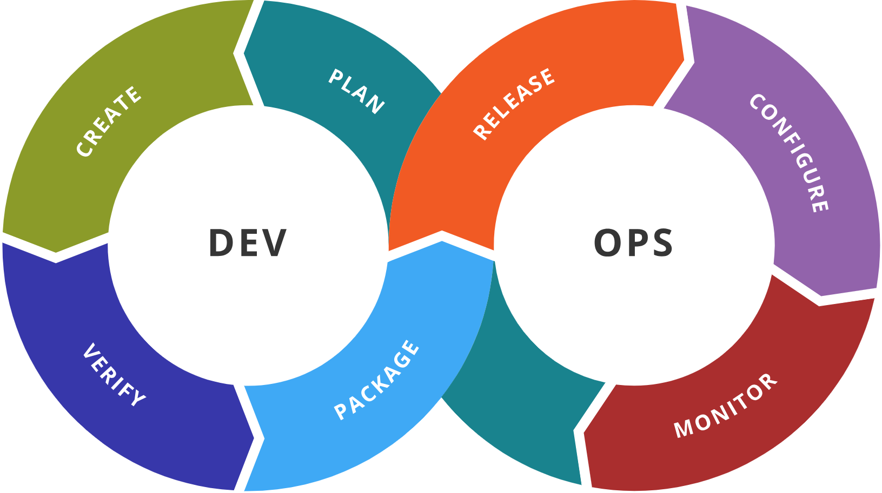
What is DevOps:

Slide 8
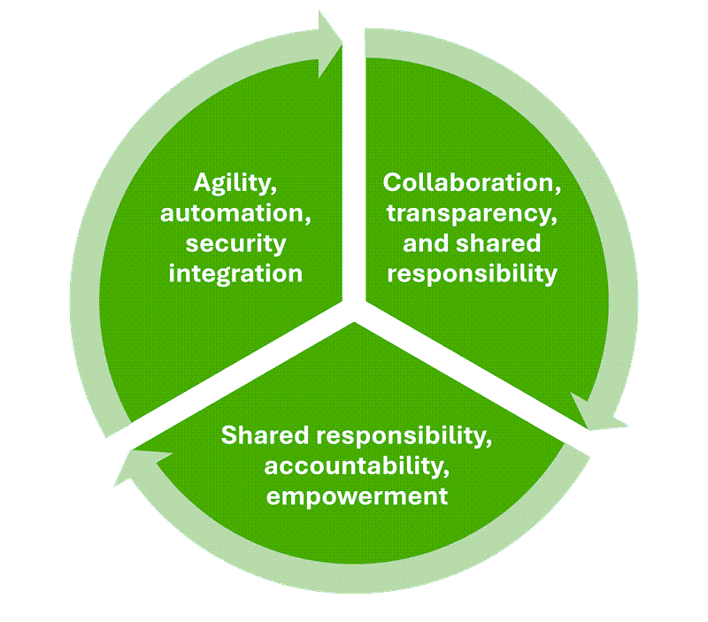
What are the key elements of DevOps culture?

Slide 9
DevOps goals and benefits:
Accelerating time to market
Adapting to market dynamics and competition
Sustaining stability and reliability in operations
Minimizing the mean time to recovery (MTTR)
It's important to note that DevOps benefits extend beyond the lifecycle of traditional applications. Its scope includes, for example, such areas as machine learning (with operations applied to implementing machine learning models) and infrastructure (with Infrastructure as Code applied to deployment of underlying platform services).

Slide 10
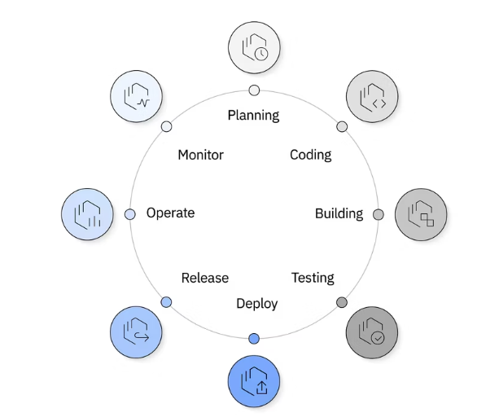
DevOps Lifecycle:
The DevOps lifecycle is designed to optimize the rapid delivery of high-quality software. It includes a series of iterative, automated workflows that run within a larger automated and iterative development lifecycle.

Slide 11
DevOps Lifecycle:
Building. New code is integrated into the existing code base, then tested and packaged for release and deployment. Activities that are often automated at this stage include merging code changes into a master copy; placing the updated code into a repository; and compiling, testing, and packaging code into an executable file. In DevOps, the output of the build phase is often stored in a binary repository. Unlike a source code repository, a binary repository stores packaged outputs, such as libraries and executable files, to be reused in other phases of the development lifecycle.
Deploy. At this stage, the project moves to a production environment where users can access the updated application. Many organizations deploy first to a subset of end users to ensure that the application works properly. When stability is established, the application can be deployed to everyone.
Operate. In this stage, DevOps teams check that new features are running smoothly and are available to users with no interruptions in service. They use automated observability and management tools to continuously monitor and optimize operations to make sure that network, storage, platform, compute and security postures are all working properly.
Monitor. At this stage, teams collect and analyze feedback from users and lessons from previous workflows to inform improvements in processes and products moving forward. This continuous monitoring of features, functions, performance, and business value informs the planning for the next release of new features and enhancements.

Slide 12
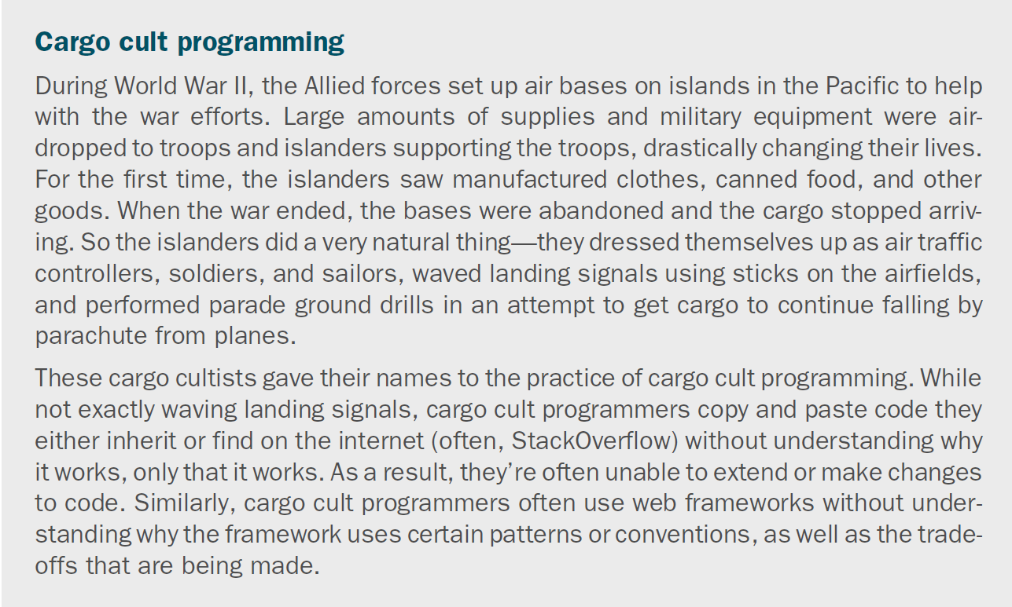

Slide 13
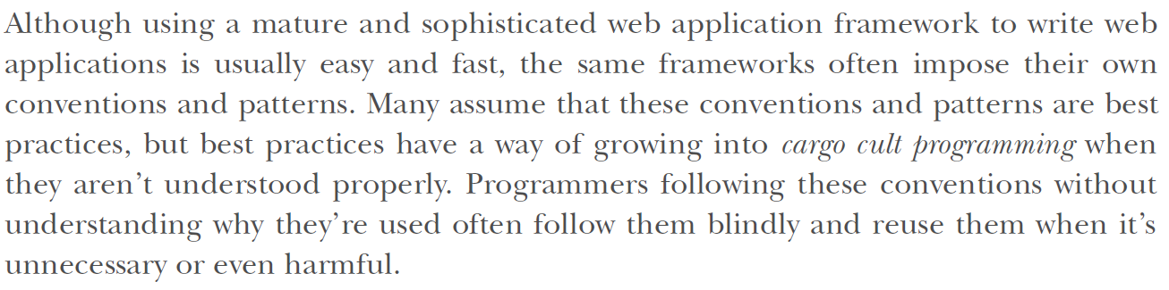

Slide 14
CI/CD:
Software development is moving fast, and every engineering team says they are shipping 10x faster with the help of AI. With speed, it is important to maintain the quality of software and ensure no inconsistencies or bugs are slipping through.
There are these bugs in production that happen because something wasn’t tested, merged incorrectly, or pushed a little too confidently on a Friday evening. It ended up allowing the software to be pushed out despite containing problematic content data.
CI/CD stands for Continuous Integration and Continuous Delivery/Deployment. but at its core, it’s just about making sure code changes are merged, tested, and delivered in a way that doesn’t make developers (or users) panic.
Continuous Integration (CI) is the habit of automatically checking and merging code changes into a shared repo. So instead of everyone working in silos and hoping things don’t break when merged, every push triggers a set of actions: tests run, linters catch sloppy code, and issues are flagged early.
Continuous Delivery (CD) takes that validated code and gets it ready for release, automatically.
It doesn’t push it to production without human approval, but it makes sure that when you're ready to ship, everything is packaged, tested, and waiting.

Slide 15
CI/CD Pipelines:
The continuous integration/continuous delivery (CI/CD) pipeline is an automated DevOps workflow that streamlines the software delivery process.
A vital characteristic of the CI/CD pipeline is the use of automation to help ensure code quality. As the software changes progress through the pipeline, automated tests identify dependencies and other issues earlier, push code changes to different environments and deliver applications to production environments.
Test
Deliver
Deploy
Build

Slide 16
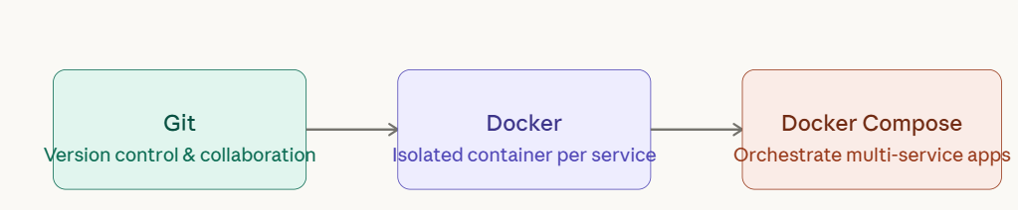
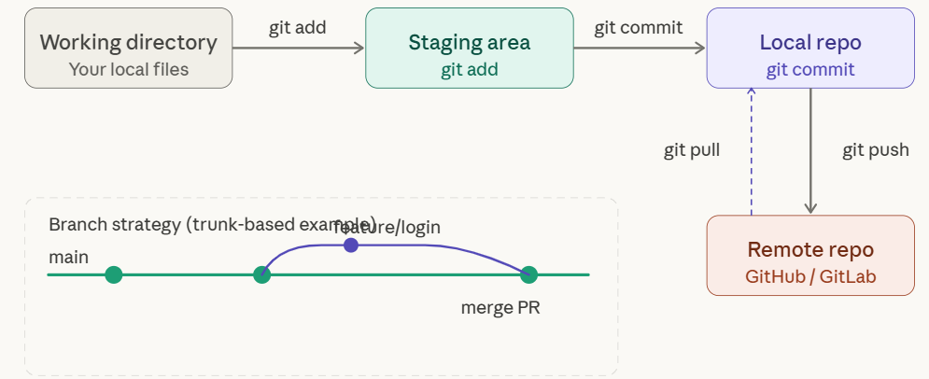
Building Our CI/CD pipeline:
Every DevOps workflow starts with source control. Git lets your whole team work on the same codebase without stepping on each other — and it gives you a full history so you can always roll back.

Slide 17
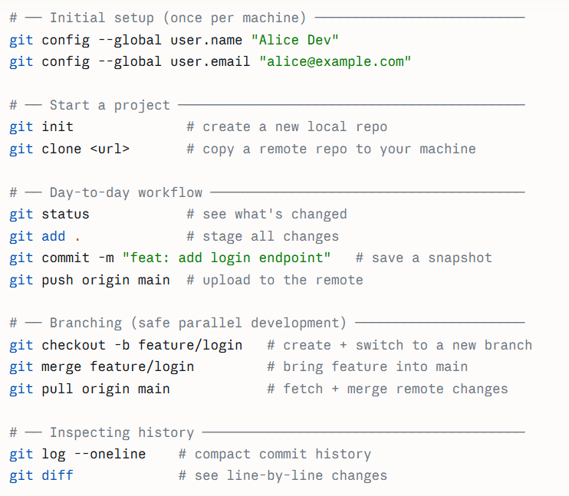
Building Our CI/CD pipeline:
Every DevOps workflow starts with source control. Git lets your whole team work on the same codebase without stepping on each other — and it gives you a full history so you can always roll back.

Slide 18
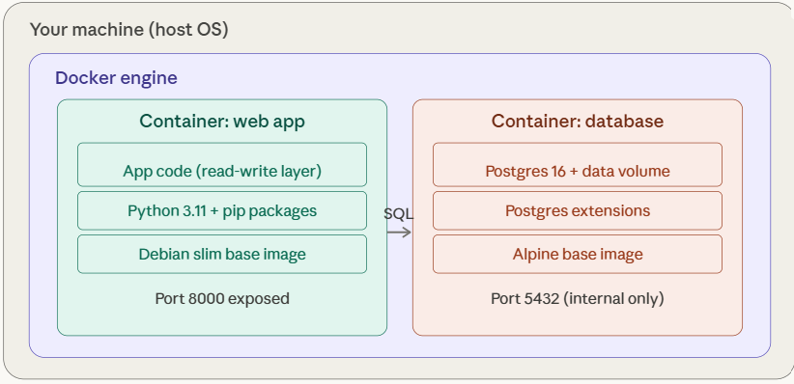
Building Our CI/CD pipeline:
Docker wraps your app and all its dependencies — runtime, libraries, OS packages — into a single portable unit called an image. When you run an image, you get a container: an isolated process with its own filesystem, networking, and process space.

Slide 19
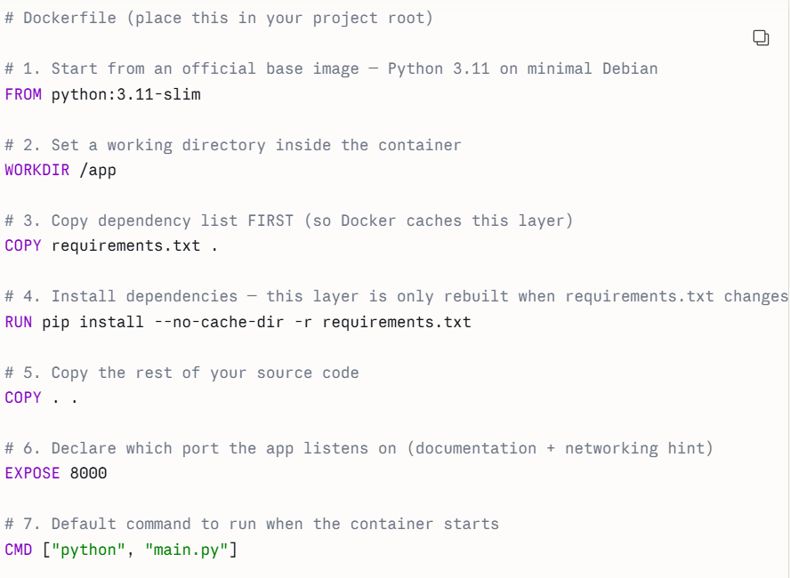
Building Our CI/CD pipeline:
Docker wraps your app and all its dependencies — runtime, libraries, OS packages — into a single portable unit called an image. When you run an image, you get a container: an isolated process with its own filesystem, networking, and process space.

Slide 20
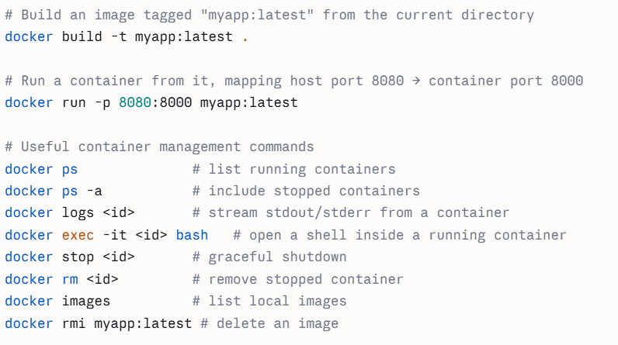
Building Our CI/CD pipeline:
Docker wraps your app and all its dependencies — runtime, libraries, OS packages — into a single portable unit called an image. When you run an image, you get a container: an isolated process with its own filesystem, networking, and process space.

Slide 21
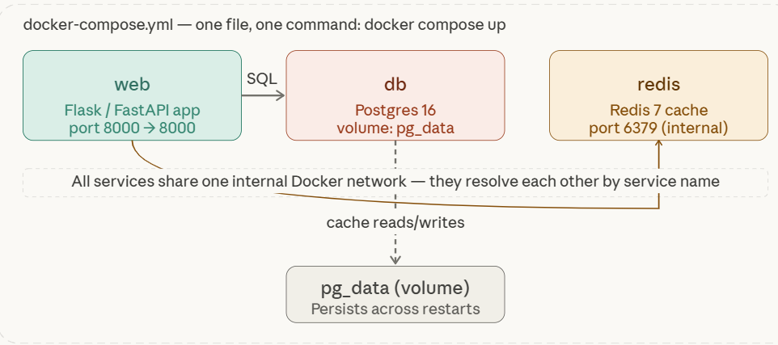
Building Our CI/CD pipeline:
Real apps have multiple services — a web server, a database, a cache, and a background worker. Running and connecting them manually with Docker run is painful. Docker Compose lets you define the entire environment in one YAML file and bring it all up with a single command.

Slide 22
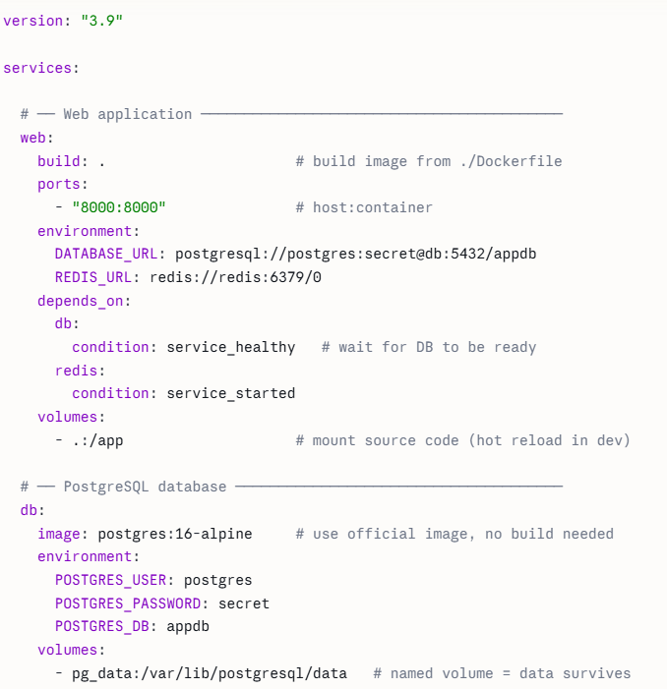
Building Our CI/CD pipeline:
Real apps have multiple services — a web server, a database, a cache, and a background worker. Running and connecting them manually with Docker run is painful. Docker Compose lets you define the entire environment in one YAML file and bring it all up with a single command.

Slide 23
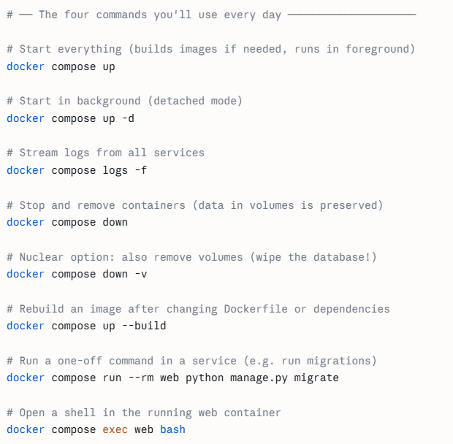
Building Our CI/CD pipeline:
Real apps have multiple services — a web server, a database, a cache, and a background worker. Running and connecting them manually with Docker run is painful. Docker Compose lets you define the entire environment in one YAML file and bring it all up with a single command.

Slide 24
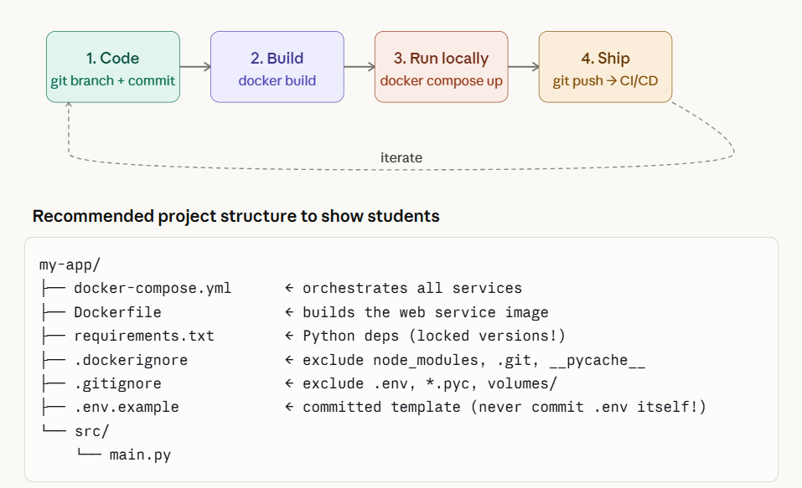
Building Our CI/CD pipeline:

Slide 25
References:
https://learn.microsoft.com/en-gb/training/paths/devops-foundations-core-principles-practices/
https://www.ibm.com/think/topics/devops
https://www.ibm.com/think/topics/ci-cd-pipeline
https://pieces.app/blog/best-ci-cd-tools VERY IMPORTANT!!!!
https://learn.microsoft.com/en-us/training/modules/introduction-to-devops/

Slide 26
THANK YOU

